Slide 1


micro:bit robot entry tutorial
Lesson 7
micro:bit robot lesson 7 “Following”
YahBoom micro:bit video tutorial

Slide 2
micro:bit robot entry tutorial
Content
Part1
Part 2
Part3
Part 4
Part 5
Learning goals
Preparation
Search for blocks
Combine blocks
Attentions
YahBoom micro:bit video tutorial

Slide 3
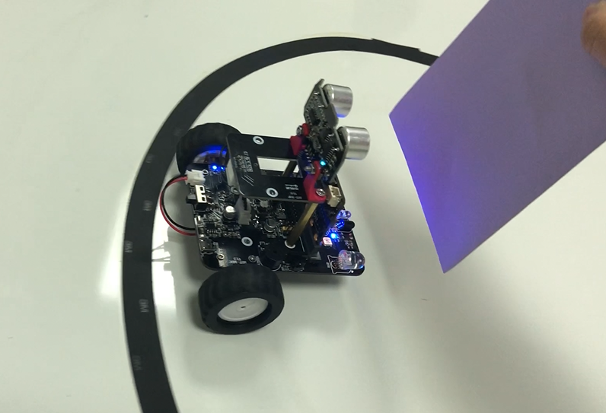
micro:bit robot entry tutorial
Part 1
Learning goals
Children, what we learn in this lesson is robot following. We can use infrared obstacle avoidance sensor to achieve robot following, or we can use ultrasonic sensor to achieve it. In this lesson, we learn to follow the infrared following. Infrared following can realize that if the robot has an object in front of the obstacle avoidance sensor, the robot will follow. If there is no object in front of the obstacle avoidance sensor, the robot will stop. Is it very interesting? Let's try the kids together.
YahBoom micro:bit video tutorial

Slide 4
micro:bit robot entry tutorial
Part 2
Hardware:
● 1 X USB cable
● 1 X micro:bit robot
Preparation
Then the micro:bit is connected to the computer through USB, and the computer will pop up a U disk and click the URL in the U disk to enter the programming interface. Input this URL https://github.com/lzty634158/yahboom_mbit_en to get the package.
YahBoom micro:bit video tutorial

Slide 5
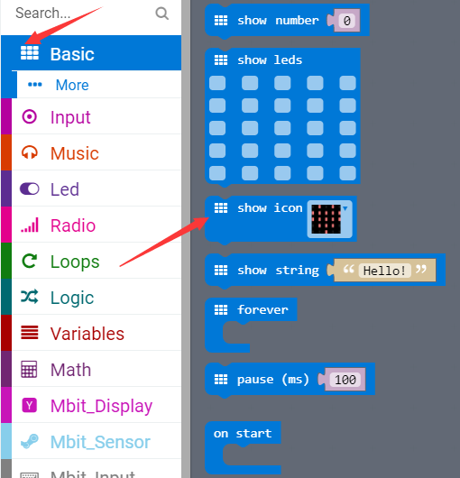
micro:bit robot entry tutorial
Part 3
Search for blocks
YahBoom micro:bit video tutorial

Slide 6
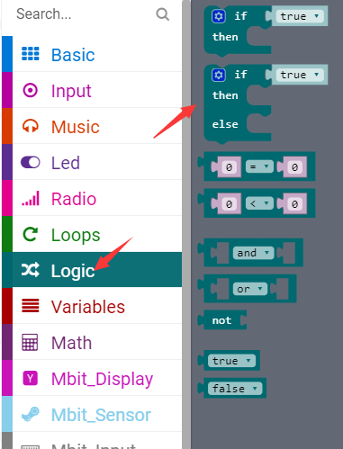
micro:bit robot entry tutorial
Part 3
Search for blocks
YahBoom micro:bit video tutorial

Slide 7
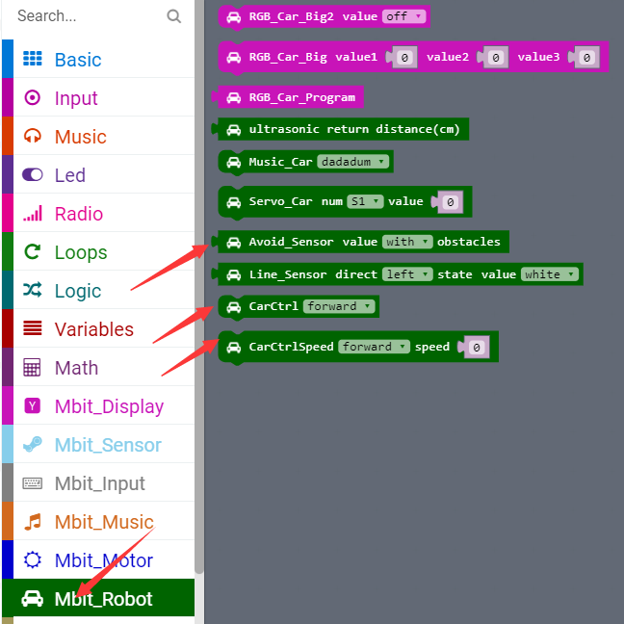
micro:bit robot entry tutorial
Part 3
Search for blocks
YahBoom micro:bit video tutorial

Slide 8
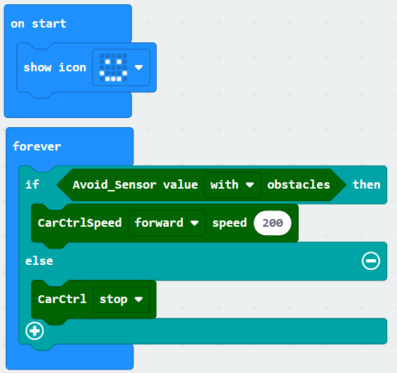
micro:bit robot entry tutorial
Part 4
Following-Infrared
Combine blocks
YahBoom micro:bit video tutorial

Slide 9
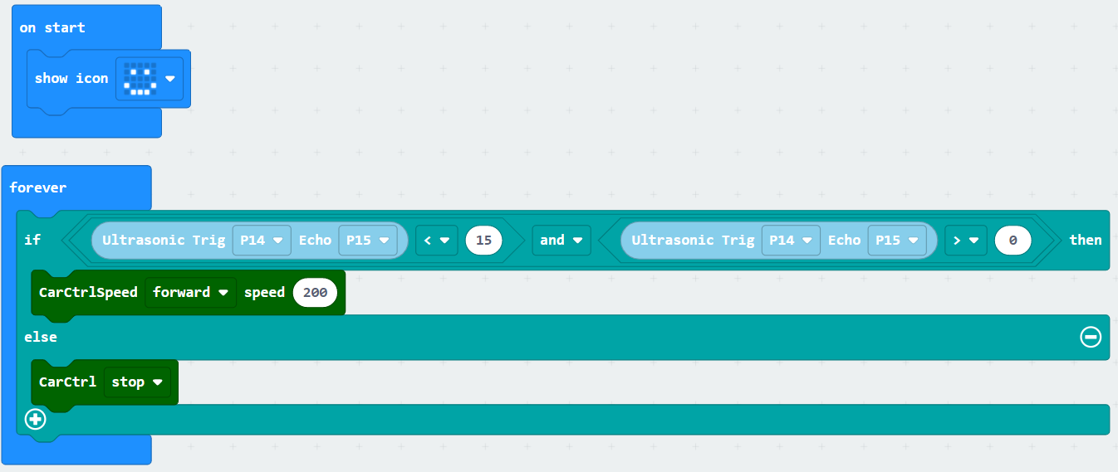
micro:bit robot entry tutorial
Part 4
Following-ultrasonic
Combine blocks
YahBoom micro:bit video tutorial

Slide 10
micro:bit robot entry tutorial
Part 5
1.This experiment must be carried out indoors to reduce interference from sunlight to infrared receiver.
2. Note:Because the infrared obstacle avoidance function of the car uses P3 (infrared receiver) and P9 pin (infrared emission) of the micro:bit board. They are multiplexed with the pins of the micro:bit dot matrix. During the experiment, some LED lights on the dot matrix may flicker.
Attentions
YahBoom micro:bit video tutorial

Slide 11
micro:bit robot entry tutorial
robot
lesson
Thanks for watching！
Powered by YahBoom
YahBoom micro:bit video tutorial

